Slide 1
Labour Market Statistics
User Group
29th September 2022
Jennifer McLoughlin
Economic and Labour Market Statistics

Slide 2
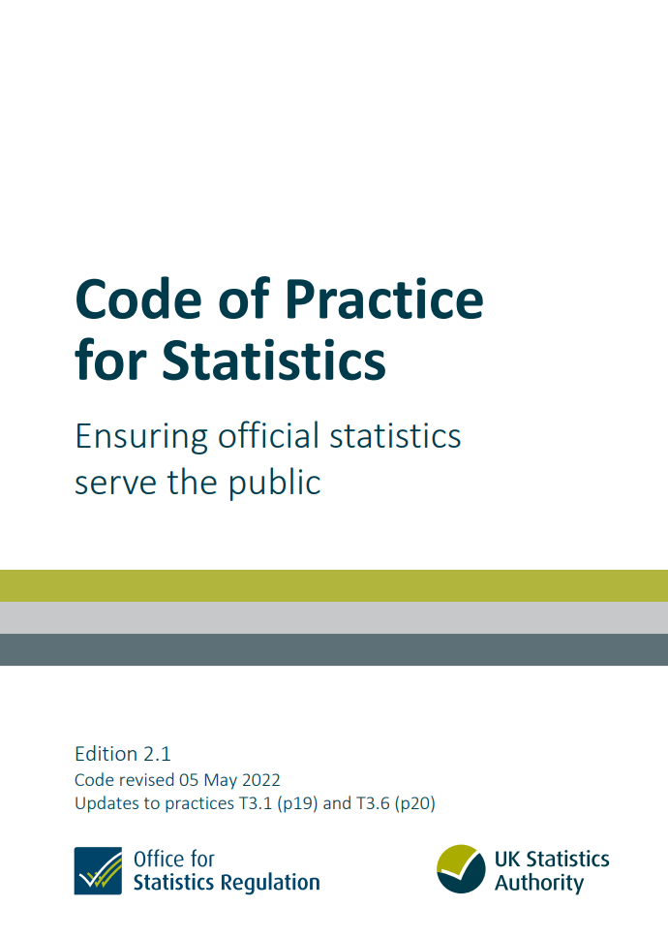
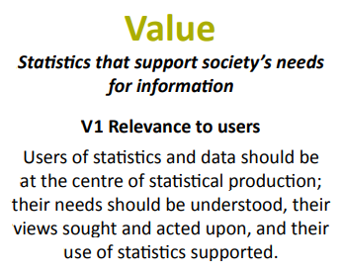
Official Statistics and User Engagement

Slide 3
Examples of engagement
Mailing lists
Newsletter
User group
Consultation
User engagement
Ad-hoc queries
Ongoing engagement
Social media

Slide 4
Aim of today’s meeting
Update users on
‘You asked – we did’
New developments – recent and planned
Obtain feedback from users on
output formats
developments
information needs

Slide 5
Agenda
Households
  Labour Force Survey (LFS) and Labour Market Report
  Census update
  Transformation of the Labour Force Survey
Q&A and Discussion
Measuring Jobs and Earnings
  Annual Survey of Hours and Earnings (ASHE)
  Business Register and Employment Survey (BRES)
  Quarterly Employment Survey (QES)
Q&A and Discussion
Close

Slide 6
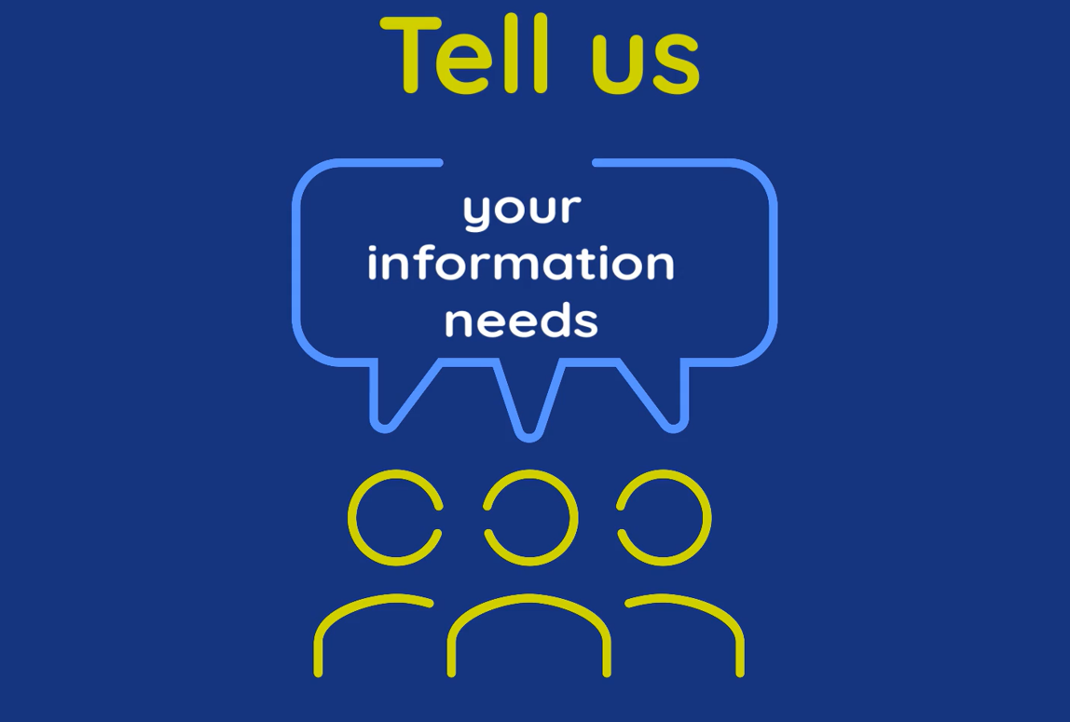
Help us shape Labour Market Statistics
Suggestions:
Closing other programs
Setting Jabber etc to ‘Do not disturb’
Mentimeter - interactive
Q&A and discussion

Slide 7
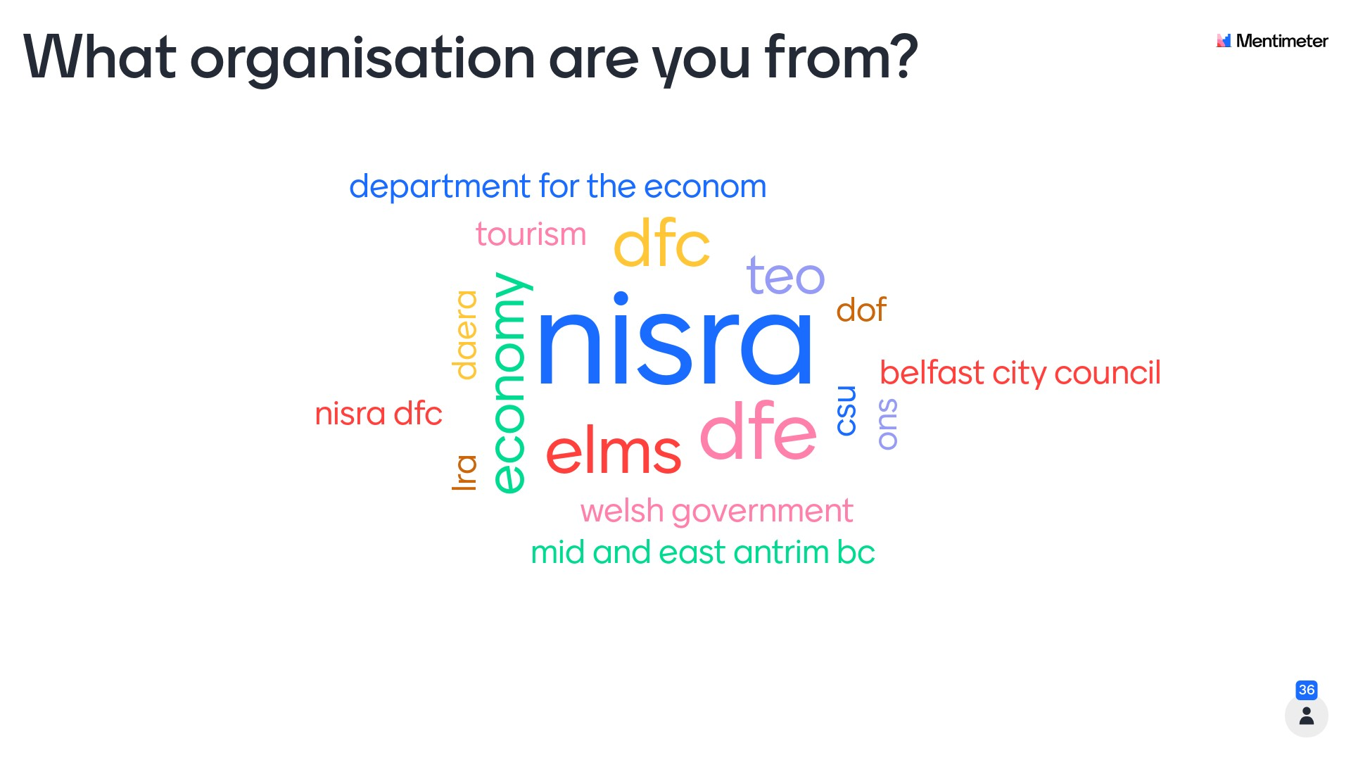
Mentimeter results – question 1

Slide 8
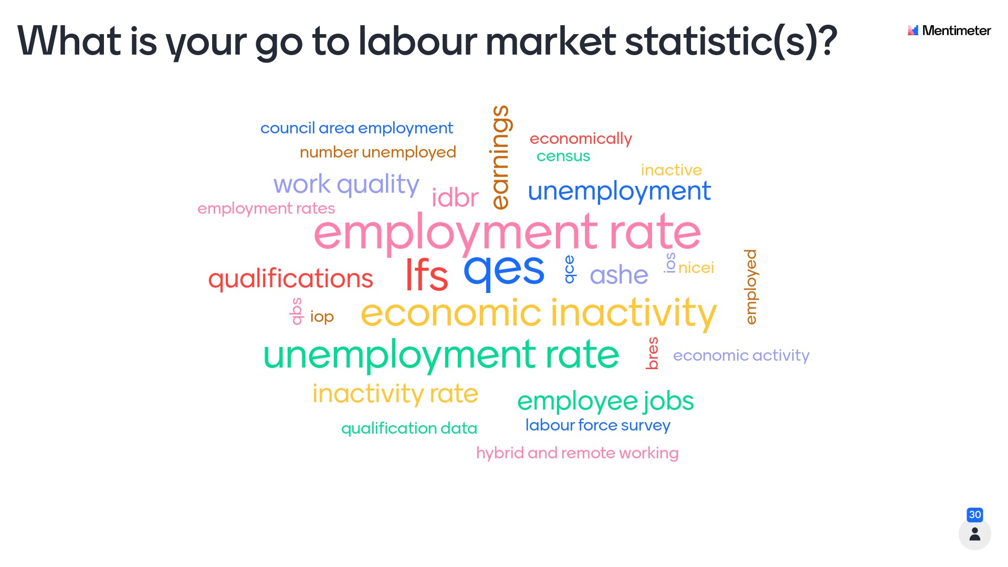
Mentimeter results – question 2

Slide 9
Labour Force Survey
Economic and Labour Market
Statistics, Mark McFetridge

Slide 10


Meet the team:
LFS, Redundancies & Claimant Count
Jennifer
McLoughlin
Holly McAteer
Mark McFetridge
Richard Ramsden
Mark Mullan
Jacquie
McManus
Janet Wright
Irene
Shooter
Work Quality
LFS
Redundancies & Claimant Count
holly.mcateer@nisra.gov.uk
mark.mullan@nisra.gov.uk
jennifer.mcloughlin@nisra.gov.uk mark.mcfetridge@nisra.gov.uk richard.ramsden@nisra.gov.uk
jacquie.mcmanus@nisra.gov.uk janet.wright@nisra.gov.uk irene.shooter@nisra.gov.uk

Slide 11
You Asked – We Did
Additional data included within the Labour Force Survey (LFS) annual tables 2020 release.
  Economic inactivity by age for LGD
  Employment and economic inactivity by LGD and disability status
Three new topic papers released containing new analysis from the LFS.
  Disability Employment Gap in Northern Ireland 2020
  Qualifications in Northern Ireland 2020
  Young people not in education, employment or training (NEET): 2020
Women in NI and Work Quality publications released.

Slide 12
You Asked – We Did
Informing the evidence base for policy
Disability in the Labour Market research
Labour Market Intelligence portal
Skills Strategy

Slide 13
Data Processing
Reweighting in October 2020 – household tenure
Reweighting in July 2021 – changes to LFS population
Reweighting in June 2022 – changes to LFS population and introduction of the non-response bias adjustment to NI data

Slide 15
Labour Market Report (LMR)
Alternative release time – 7am
Development of LMR publication and output – using reproducible analytical pipelines (RAP)

Slide 16
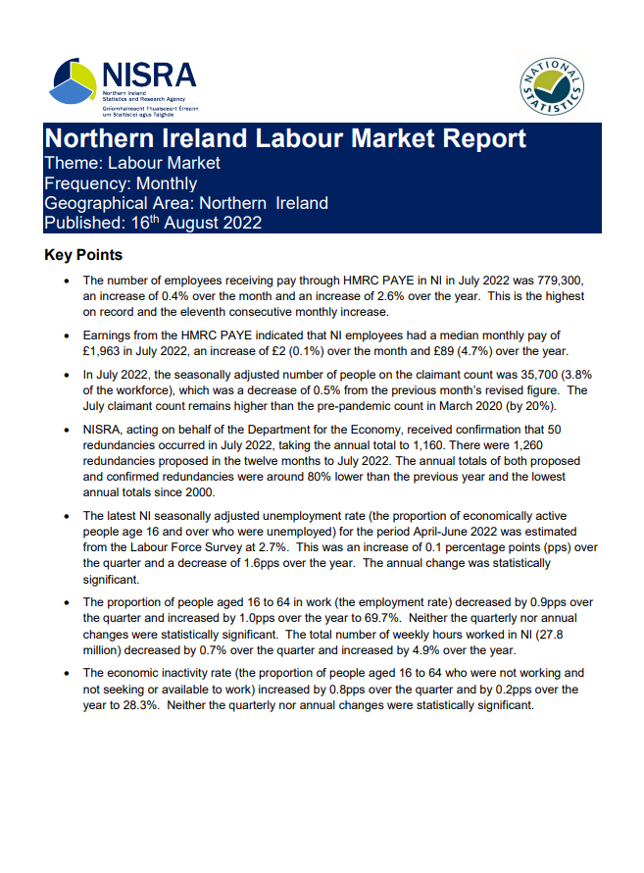
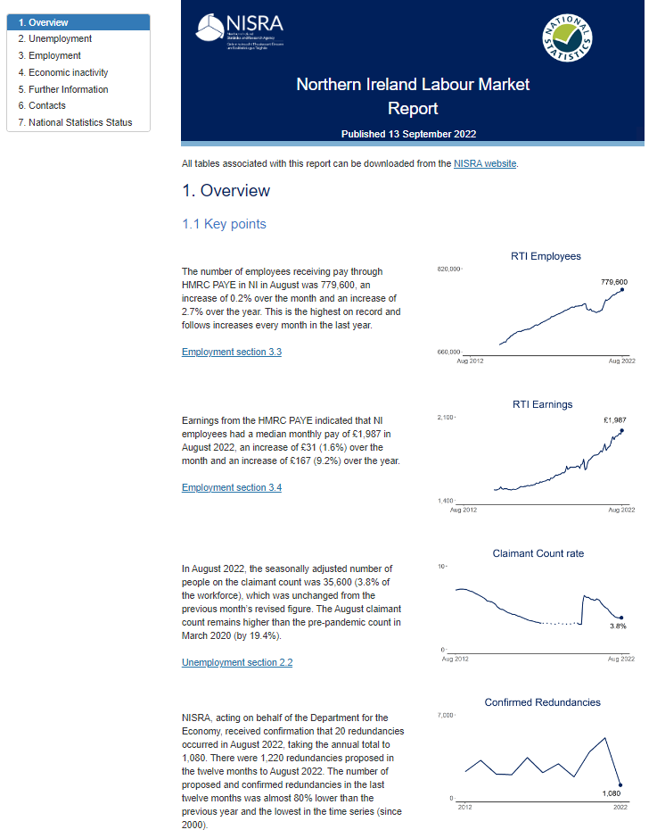
Labour Market Report (LMR)
Development
PDF Version
(August 22)
HTML Version
(September 22)

Slide 17
LMR – Change of Format
HTML LMR Page
  https://datavis.nisra.gov.uk/economy-and-labour-market/labour-force-survey/labour-market-report-september-2022.html

Slide 18
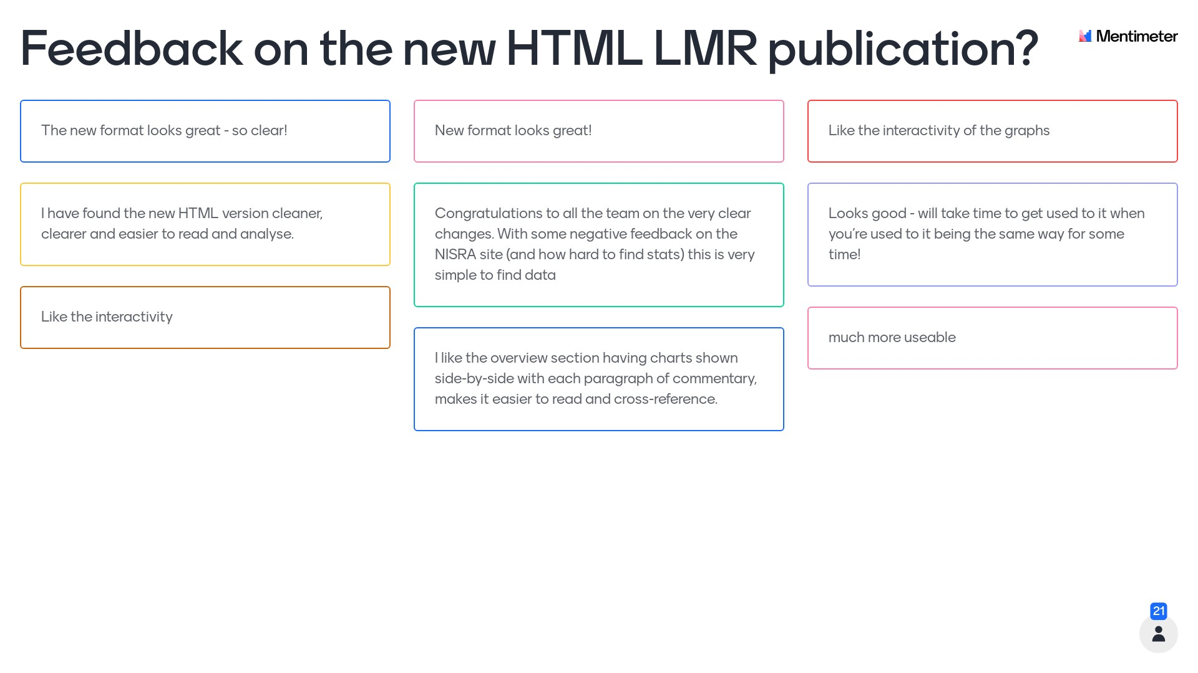
Mentimeter results – question 3

Slide 19
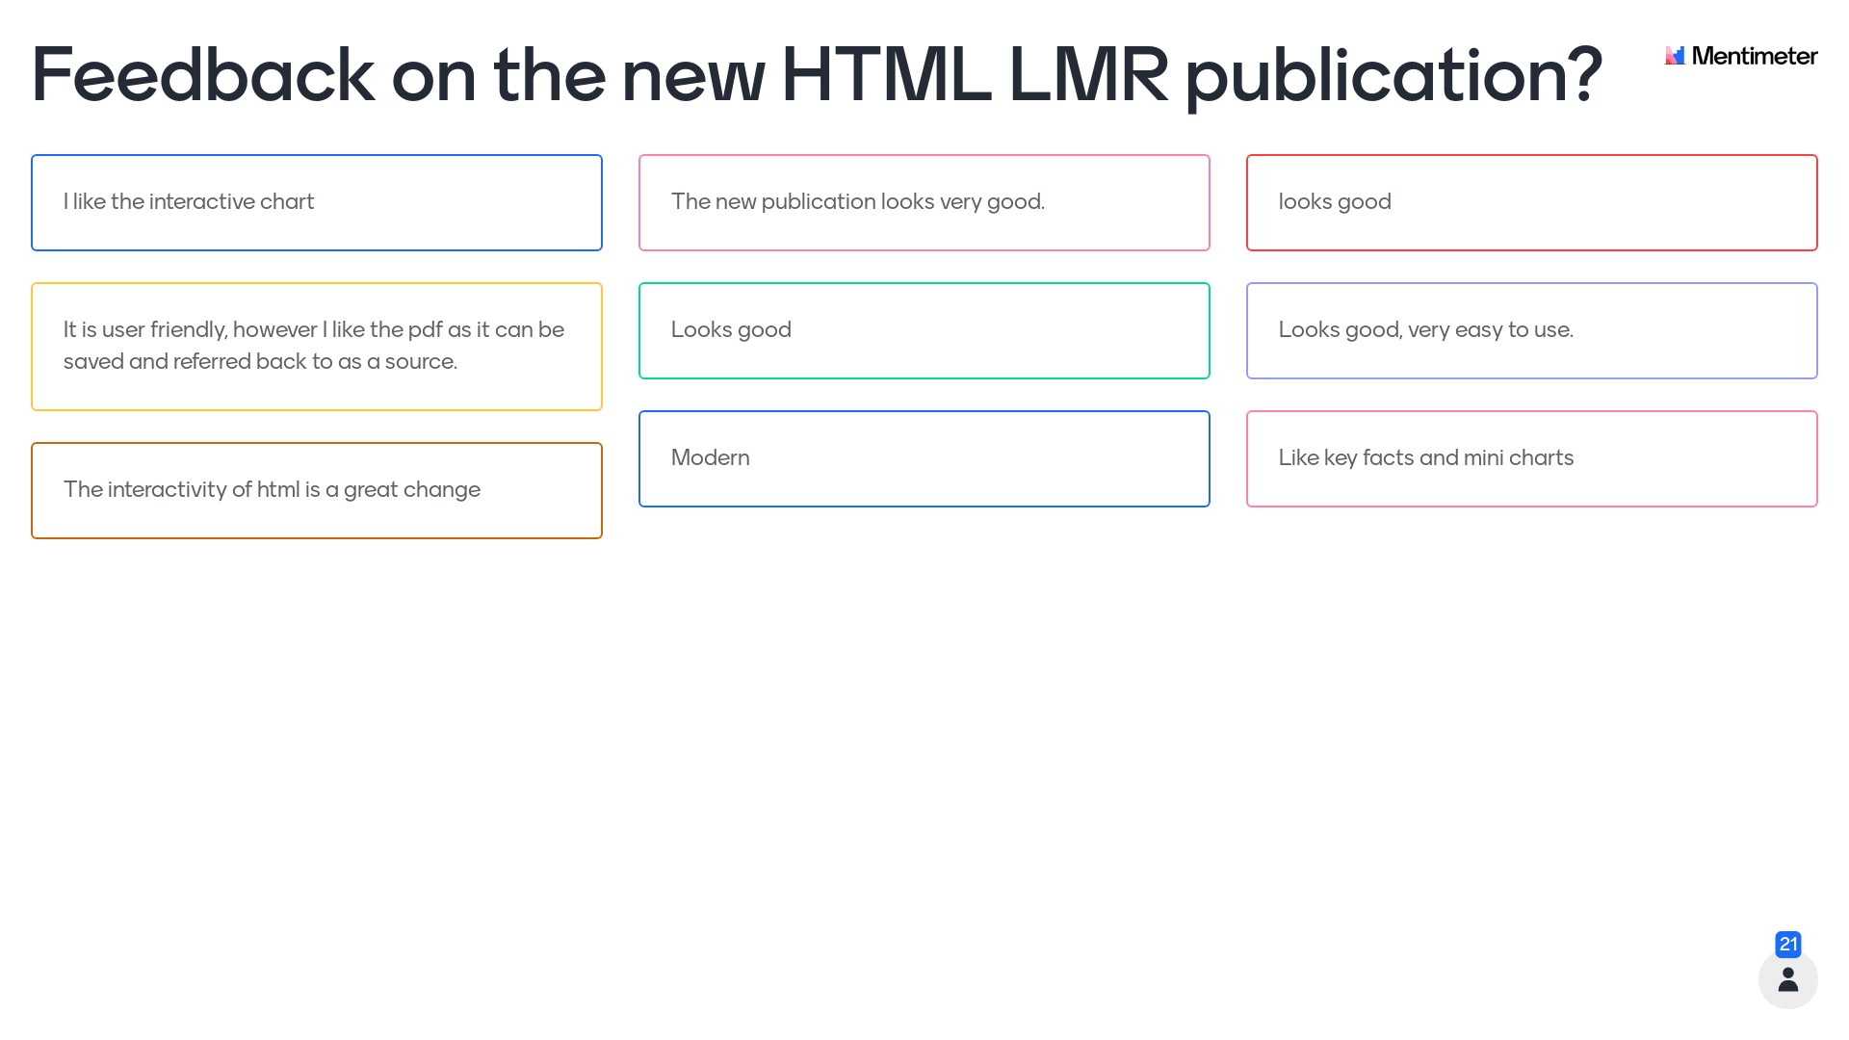
Mentimeter results – question 3

Slide 20
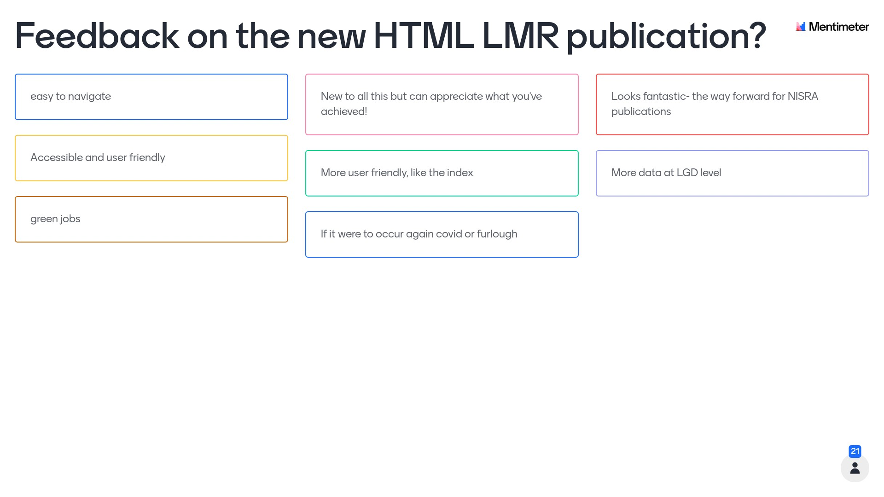
Mentimeter results – question 3

Slide 21
LMR – Change of Format
LMR and data tables contained on one web page.
All data tables now accessible.
Data tables streamlined.
Key points now consists of data chart and brief summary.
All LMR sections streamlined.
Each data section follows the same format.
Interactive charts.
Supplementary document created to contain reference information.

Slide 22
New questions
  Settled status
  Work quality
  Levels of support from immediate line manager.
  Skills required to perform work duties (skills mismatch).
  Experiences of bullying and harassment.
  Education

Slide 23
Plans for the future
October/November
LFS Annual Summary Report 2021 – 13th October 2022.
(headline LGD breakdowns will also be released for 2021)
Digital Skills
Young people not in education, employment or training (NEET) – November 2022.
Additional breakdowns of annual data for 2021 – November 2022
Early 2023
Work Quality – February/March 2023.
Additional topic paper.
Please get in touch if you would like to be added to the LFS mailing list for new outputs - email LFS@finance-ni.gov.uk

Slide 24
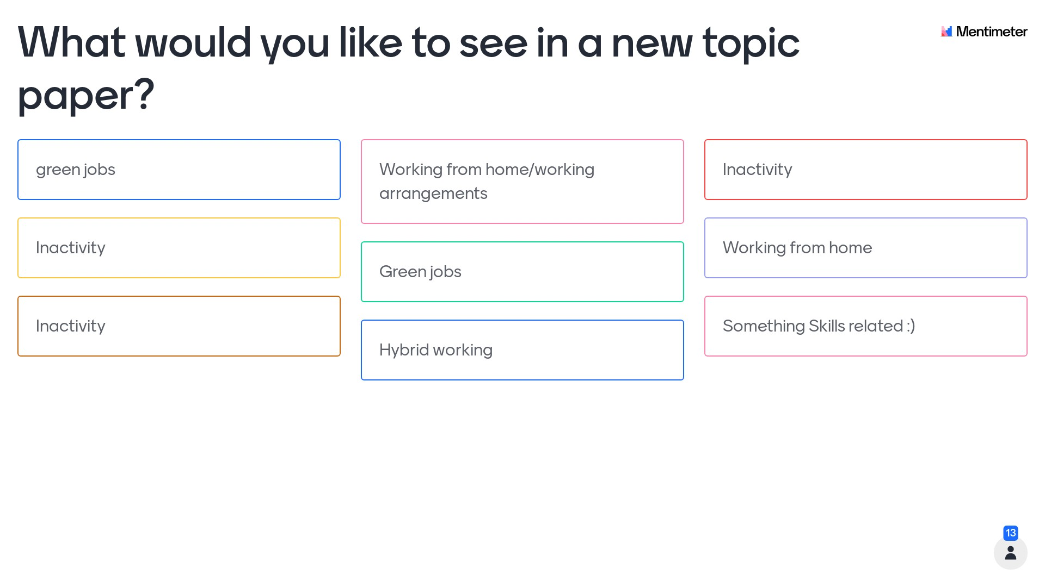
Mentimeter results – question 4

Slide 25
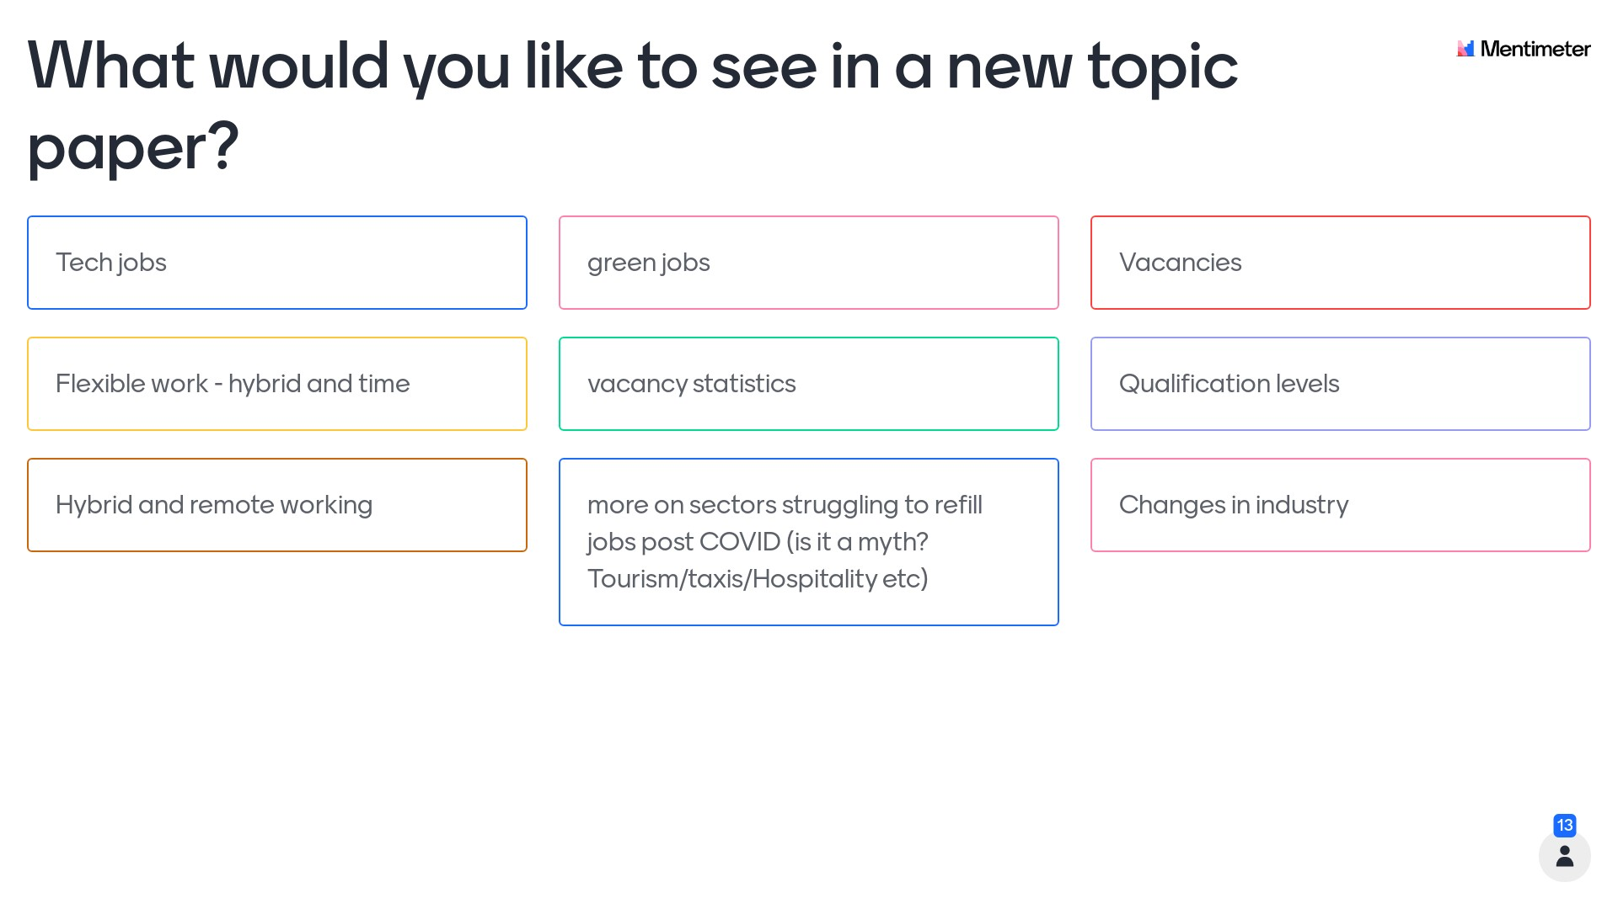
Mentimeter results – question 4

Slide 26
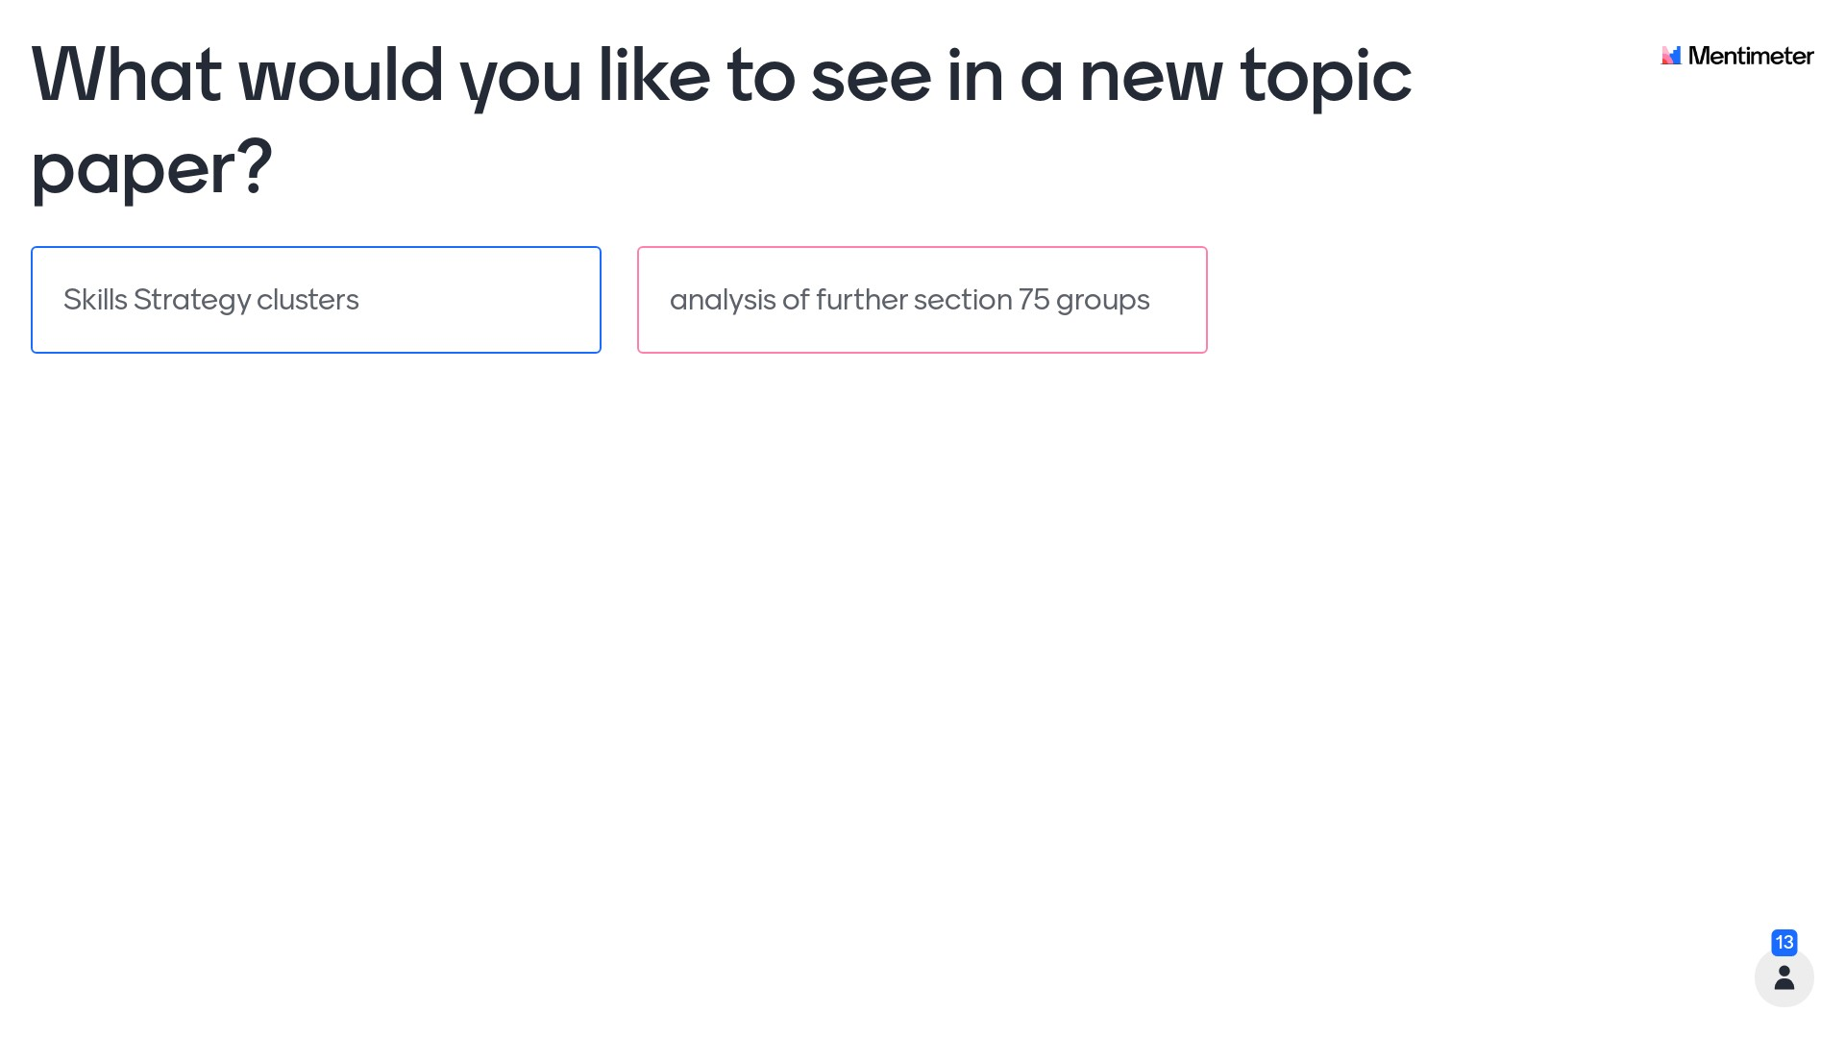
Mentimeter results – question 4

Slide 27
Census Outputs
First Release – 24 May 2022
Northern Ireland population, published in rounded form.
Release 2 (Phase 1) – 22 September 2022
Finalised, unrounded estimates of the Northern Ireland population and 11 LGDs.
Release 2 (Phase 2) – Winter 22/23
Labour Market statistics released.
Release 3 – Spring 2023
Multivariate tables.

Slide 28
Earnings
Annual Survey of Hours and Earnings (ASHE)
Ashleigh Warwick

Slide 29
Meet the team: Earnings
Brian Grogan
Steven Roberts
brian.grogan@nisra.gov.uk
steven.roberts@nisra.gov.uk
Ashleigh Warwick
ashleigh.warwick@nisra.gov.uk

Slide 30
Annual Survey of Hours and Earnings
ASHE 2022
Data
collection
Outputs

Slide 31
Data Collection
99%
Flexibility
Follow-up
Online first approach
Efficiency
Completion time
Quality
Cost
Timeliness
Time

Slide 32
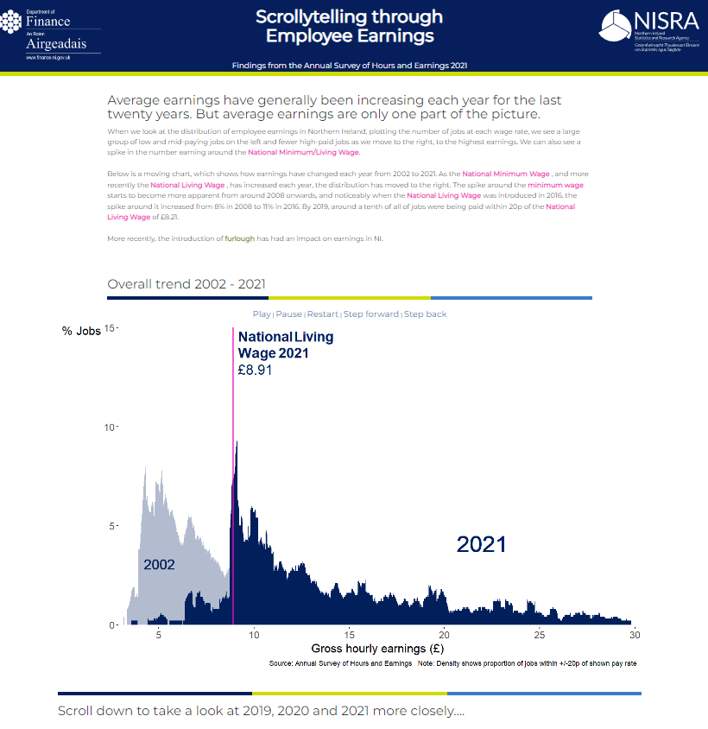
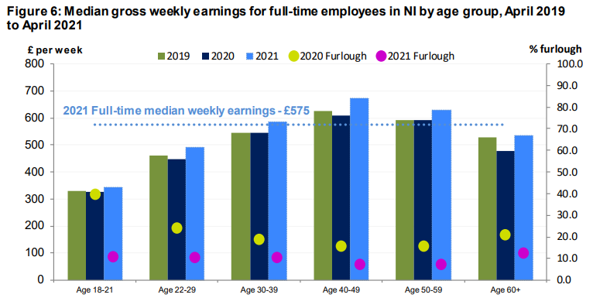
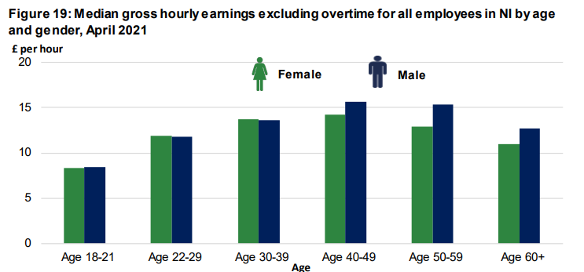
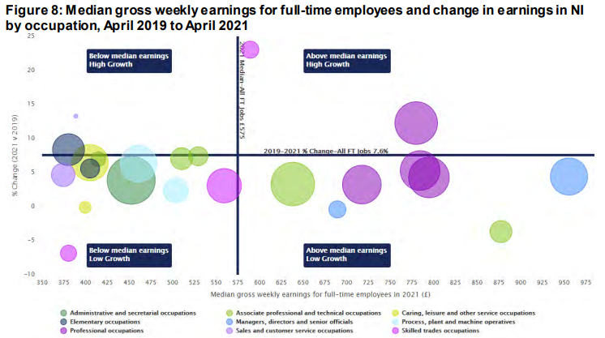
You asked - we did…
Estimates for the last two years included employees who were furloughed – Furlough section
Gender pay gap changed to focus on all employees
Detailed tables – accessible format
Change of occupation coding - new SOC20 classification
New interactive bubble chart
Scrollytelling through Employee Earnings

Slide 33
ASHE Outputs
3rd November
9:30am
(provisional)
HTML format
ASHE 2022
Scrollytelling article
Overview of earnings
Focus on real earnings
Low & high pay analysis
Gender pay gap
SOC20 classification
Accessible tables

Slide 34



Earnings and Employees Study (EES) 2011
Description
The EES 2011 links together variables from the Annual Survey of Hours and Earnings (ASHE) 2011 with aggregated variables from the Census of Population and Housing 2011, and Capital Value data from the Land and Property Service.
Accredited researchers
Access to the EES dataset is limited to researchers and research teams with accredited researcher status , who will be required to complete an application for approval by the UK Statistics Authority Research Accreditation Panel (RAP).

Slide 35
Earnings and Employees Study (EES) 2011 Projects
Association between unpaid caring and employment and earnings in NI
The combine dataset allows for associations between the unpaid carers identified from the Census and their employment and earnings from ASHE. Results will:
provide policy relevant information to Carers NI,
help inform the policy debate on employment/income related issues associated with unpaid caring,
providing greater evidence to drive policy and legislative change.
Catholic-Protestant earnings differentials in NI
The EES data will be used to:
estimate Catholic-Protestant wage differentials in NI (including separately by sex),
examine how much of any such differentials can be explained (or perhaps even obscured) by differences in characteristics between Catholics and Protestants such as age, education, and geography

Slide 36
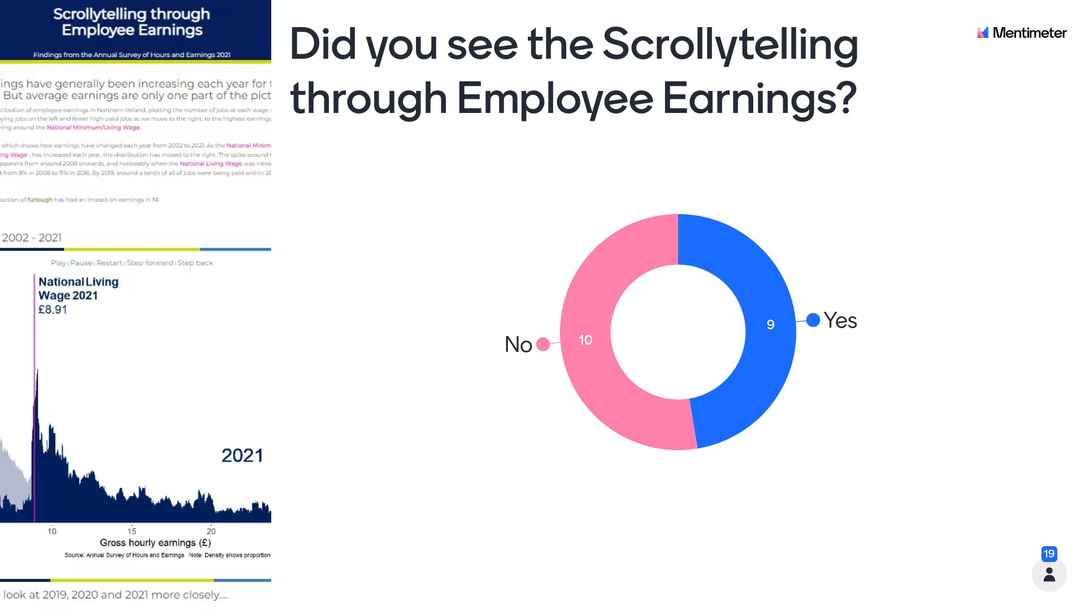
Mentimeter results – question 5

Slide 37
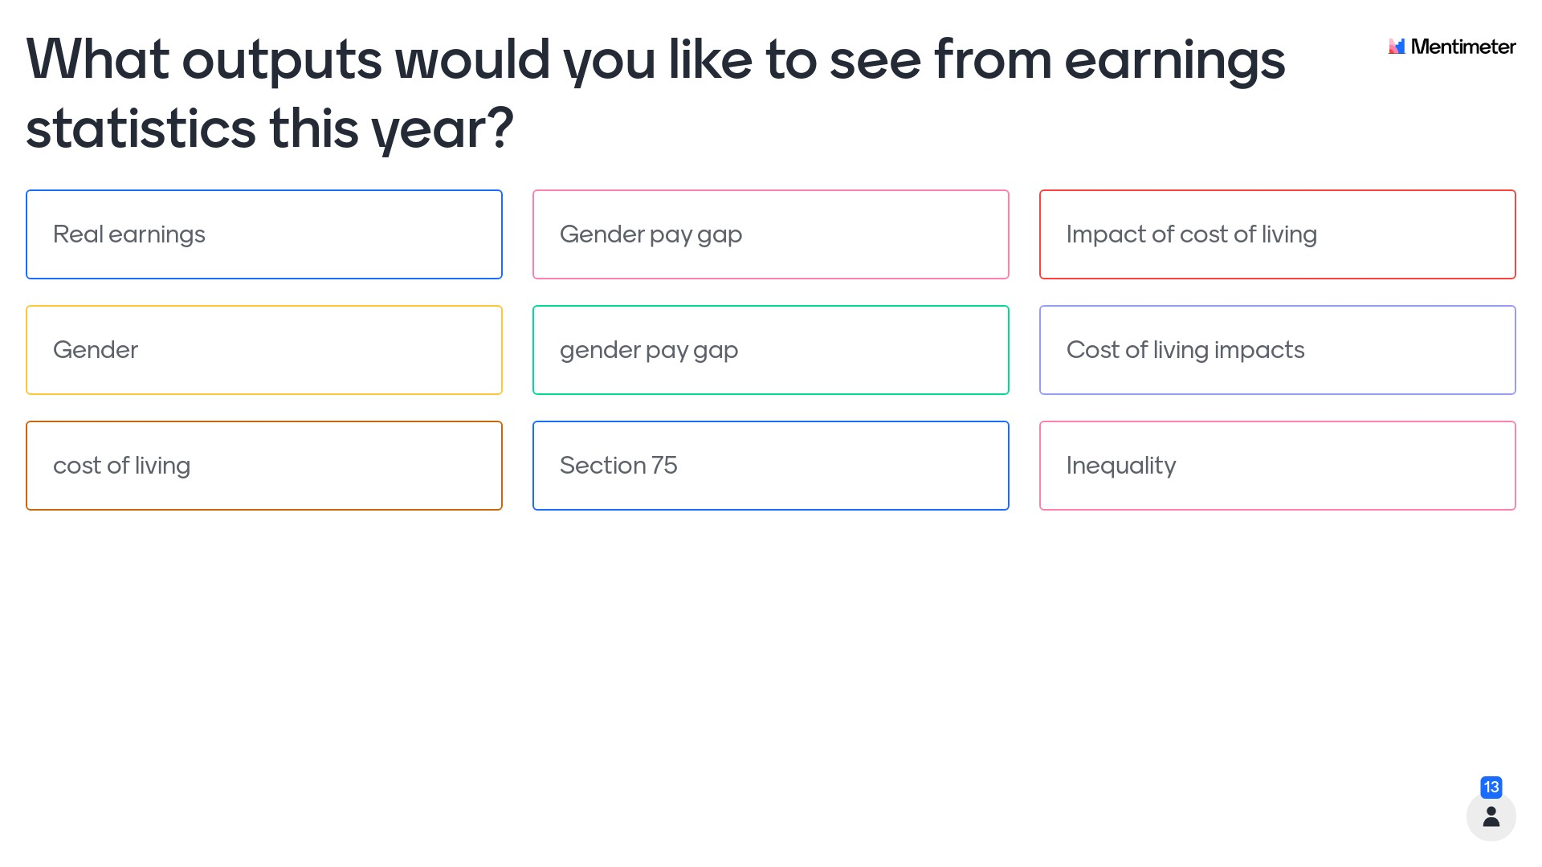
Mentimeter results – question 6

Slide 38
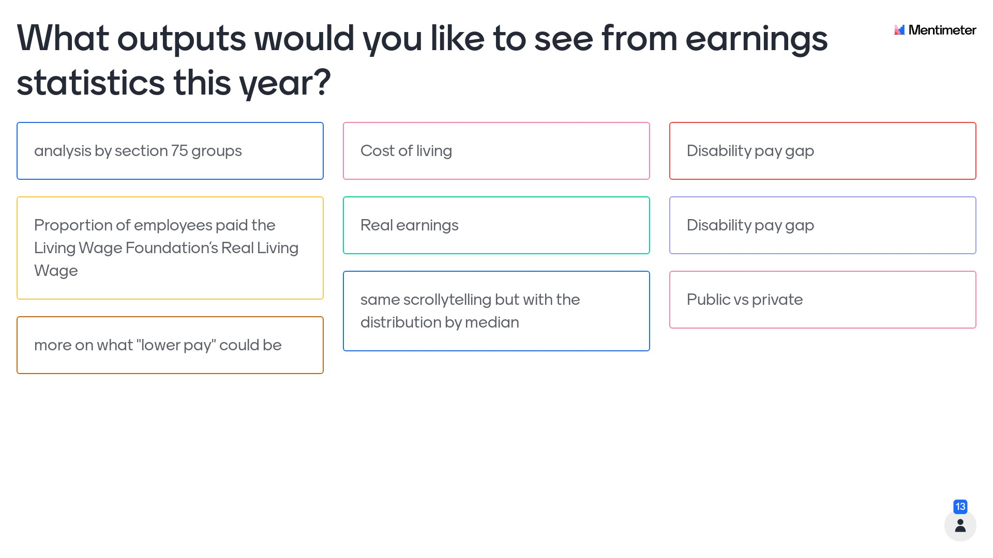
Mentimeter results – question 6

Slide 39
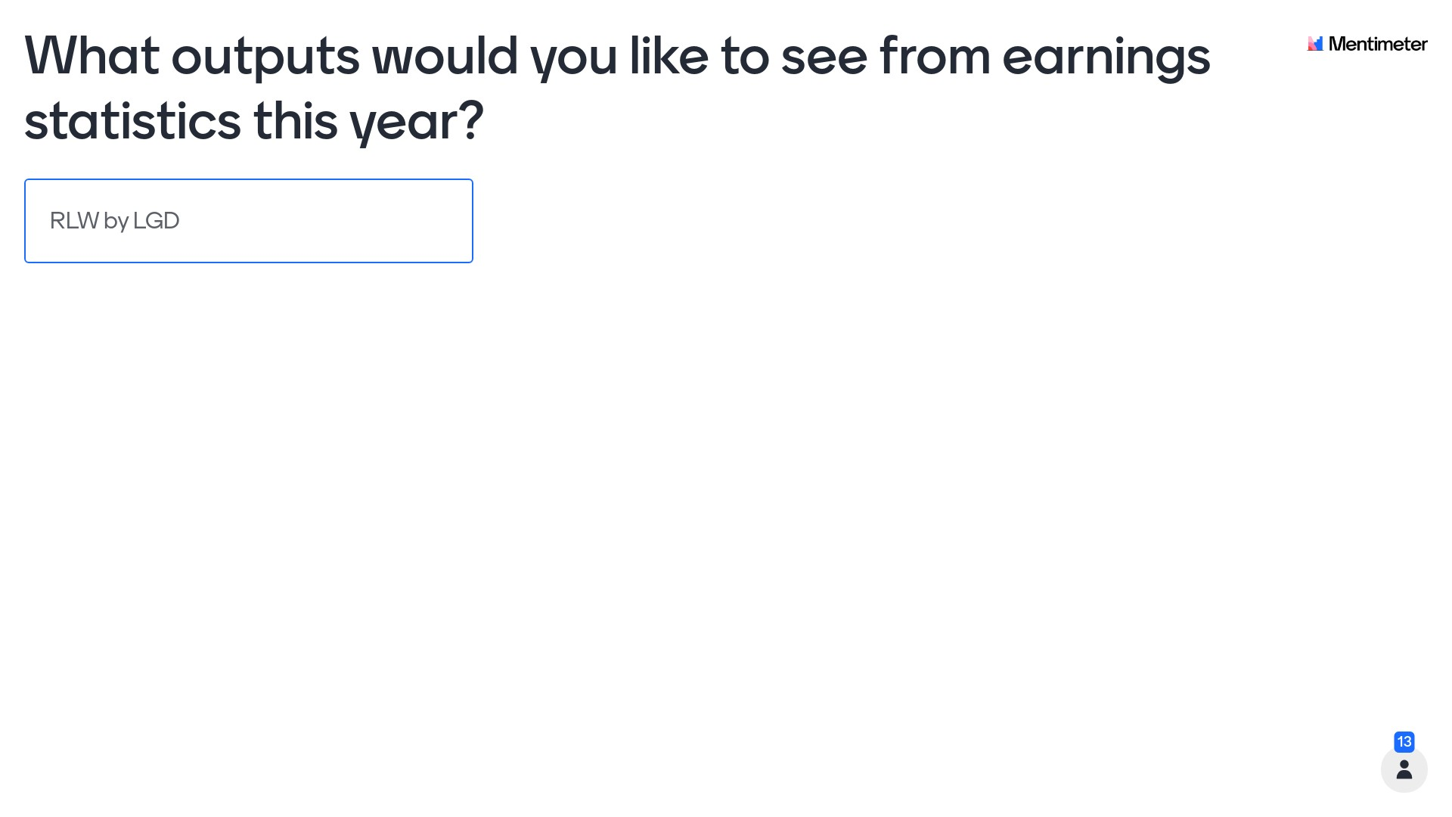
Mentimeter results – question 6

Slide 40
Business Register and Employment Survey
(BRES)
Andrew Dunn

Slide 41

Meet the team: BRES and IDBR
Arlene Connolly
arlene.connolly@nisra.gov.uk
Andrew Dunn
BRES
Neil Mulhern
IDBR
andrew.dunn@nisra.gov.uk
neil.mulhern@nisra.gov.uk
BRES Data Collection Team
IDBR Team

Slide 42
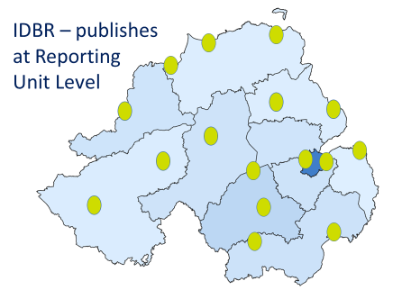
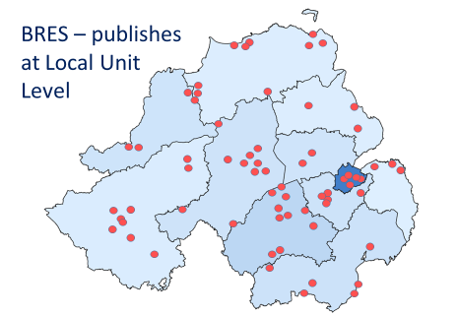



IDBR & BRES Difference

Slide 43



BRES Survey Cycle
Collects employee job data by geography and industry annually
Sample size changes from one year to next
This affects the level to which the data can be disaggregated
A larger sample size allows for smaller geographies and lower level industries
Small
n~16,000
2021
2022
2020
2023
Big
n~33,500
Big
n~35,000

Slide 44
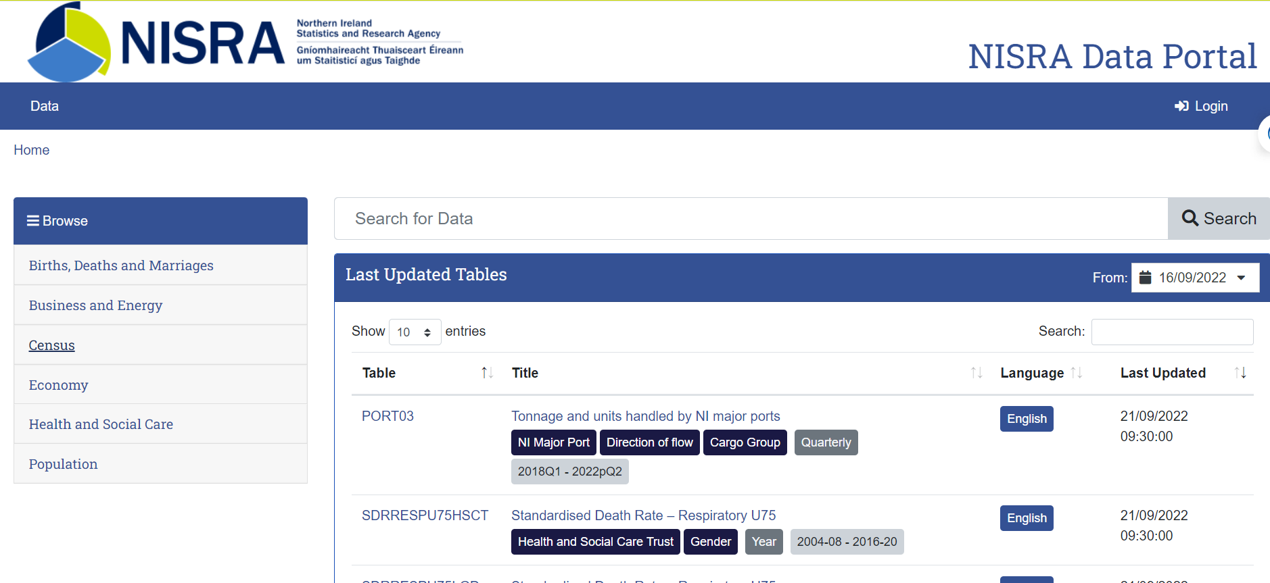
New PxStat Site

Slide 45
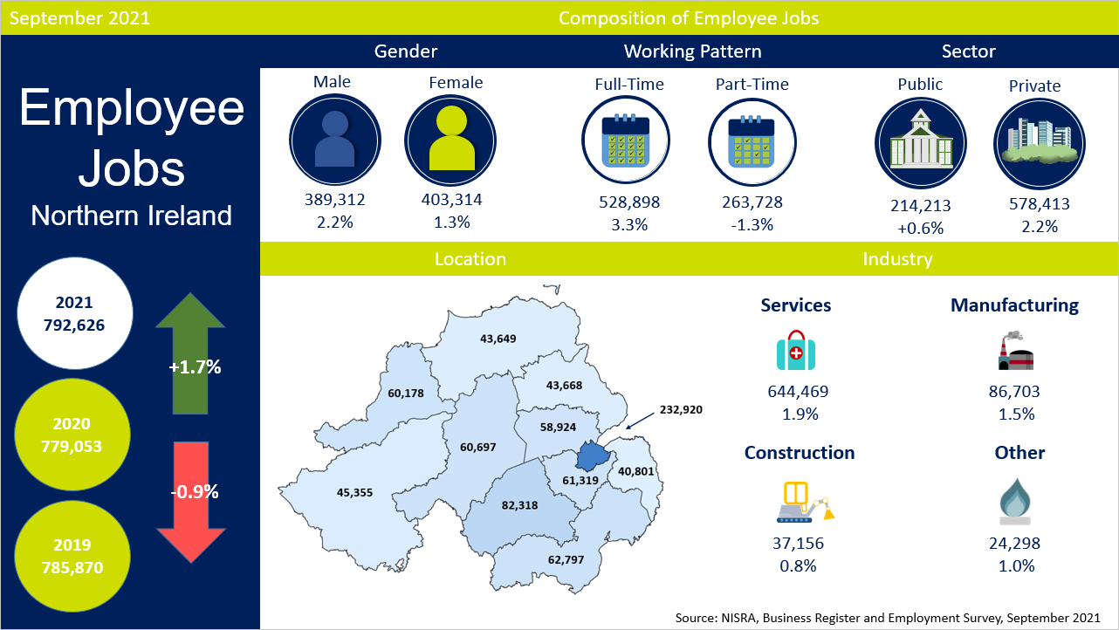

Slide 46
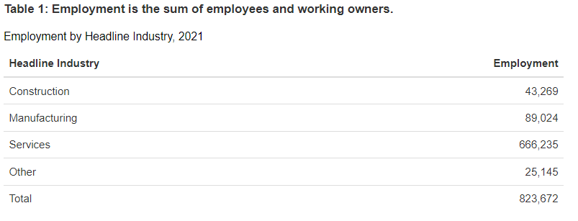
You Asked - We Did
Employment Figure
Employment = Employees + Working Owner
BRES 21 Employment figure published
  Headline Industry
  District council area level.
Largest number of working
owners found in
Construction

Slide 47
Developments
Further disaggregation of NI employment data
Publish BRES data to PxStat
Review disclosure control methodology
Review how we present Confidence Limits

Slide 48
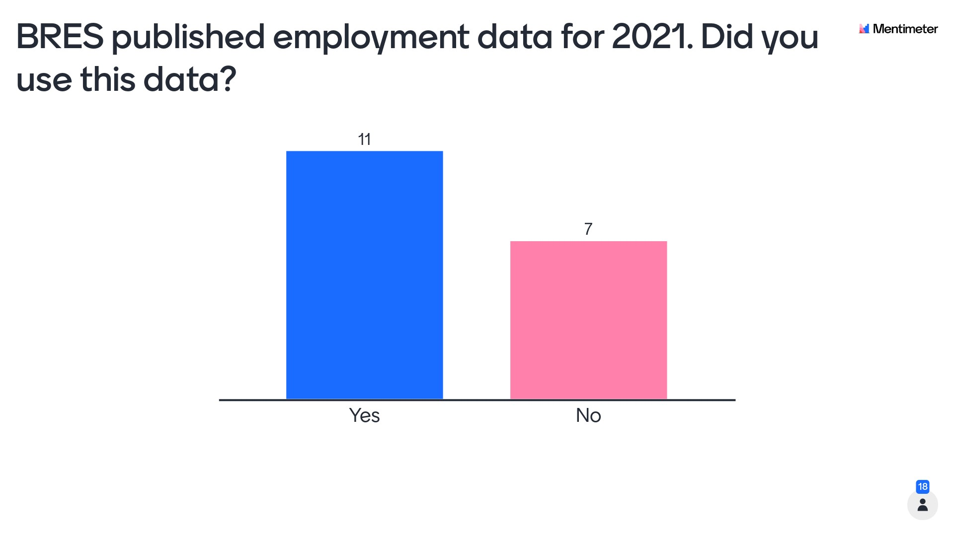
Mentimeter results – question 7

Slide 49
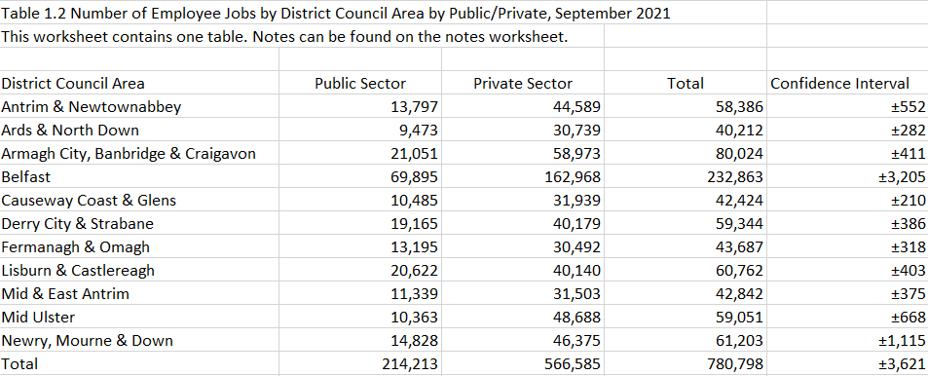
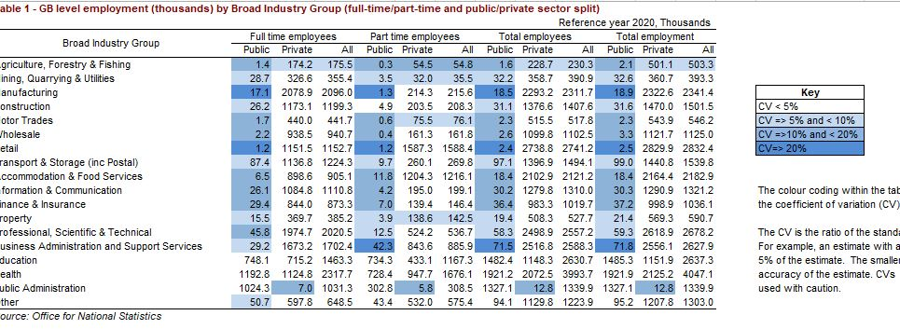
We are proposing to change the way in which the margin of error is presented in the BRES output. Are you content with the proposed changes?
Current
Proposed

Slide 50
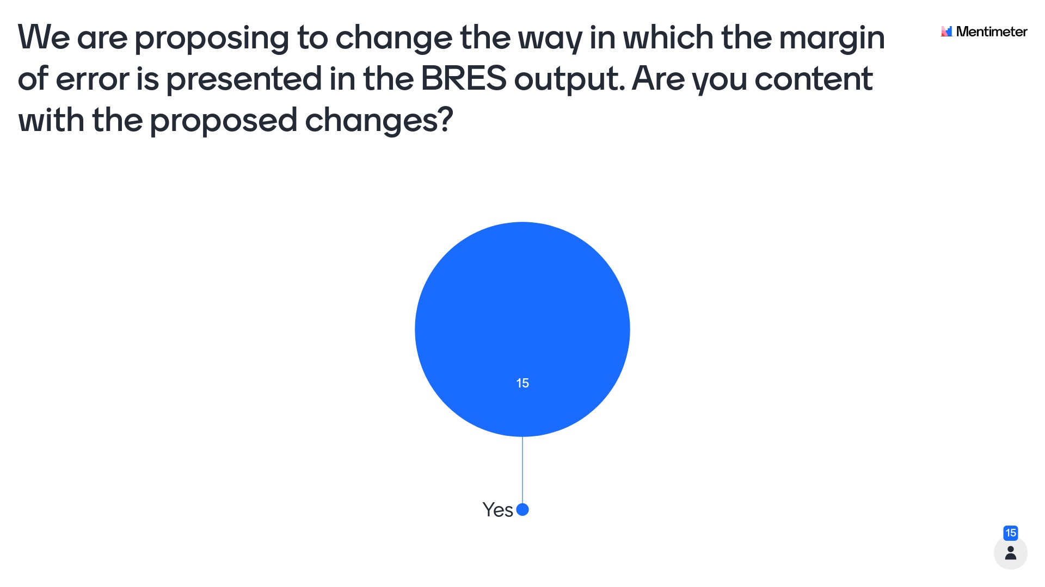
Mentimeter results – question 8

Slide 51
Quarterly Employment Survey (QES)
Ciaran Kerr

Slide 52

Quarterly Employment Survey (QES)
Meet the team
Carole-Ann McKay
Ciaran
Kerr
Data Collection Team
Carole-ann.mckay@nisra.gov.uk
Ciaran.kerr@nisra.gov.uk
Suzanne
Cassidy
Adam
McMinn
Suzanne.cassidy@nisra.gov.uk
Adam.mcminn@nisra.gov.uk

Slide 53
Quarterly Employment Survey (QES)
Overview
Short term estimates of employee jobs in NI through a quarterly sample survey of approx. 6,000 businesses.
Only includes Pay As You Earn (PAYE) jobs – the self employed are not included.
Counts jobs rather than people.
Geography level – Northern Ireland.
QES estimates are used in the calculation of:
  ONS UK Workforce Jobs
  ONS UK Public Sector Employment estimates
  NICEI calculations

Slide 54
Quarterly Employment Survey (QES)
Latest Publication
Published on 13th September 2022 at 7.00am for Quarter 2 2022.
The survey date for Quarter 2 was 30th May 2022.
Statistical bulletin can be found on the QES section of the NISRA website.
Web page also includes supplementary and historical data tables, along with background information and revisions.

Slide 55

Quarterly Employment Survey (QES)
The impact of COVID-19 on the data collection and validation of employee jobs data.
  Business closures – fewer responses and reduced business contact for validating data.
  Impact on coverage response rate still seen in 2022.
*median value achieved at QES database closure of quarter 1, quarter 2, quarter 3 and quarter 4.
As a result:
  estimates for 2020, 2021 and 2022 may be subject to higher revisions than normal over the coming quarters (late returns etc.).
  estimates at lower industry levels (e.g. 2 digit Standard Industrial Classification level), should be treated with caution.
  What are we doing to improve response rates?
 | Quarter 2 2022 | 2021 (median*) | 2020 (median*) | 2019 (median*)
Coverage response rate (returned employees) | 66.5% | 66% | 64% | 77%

Slide 56
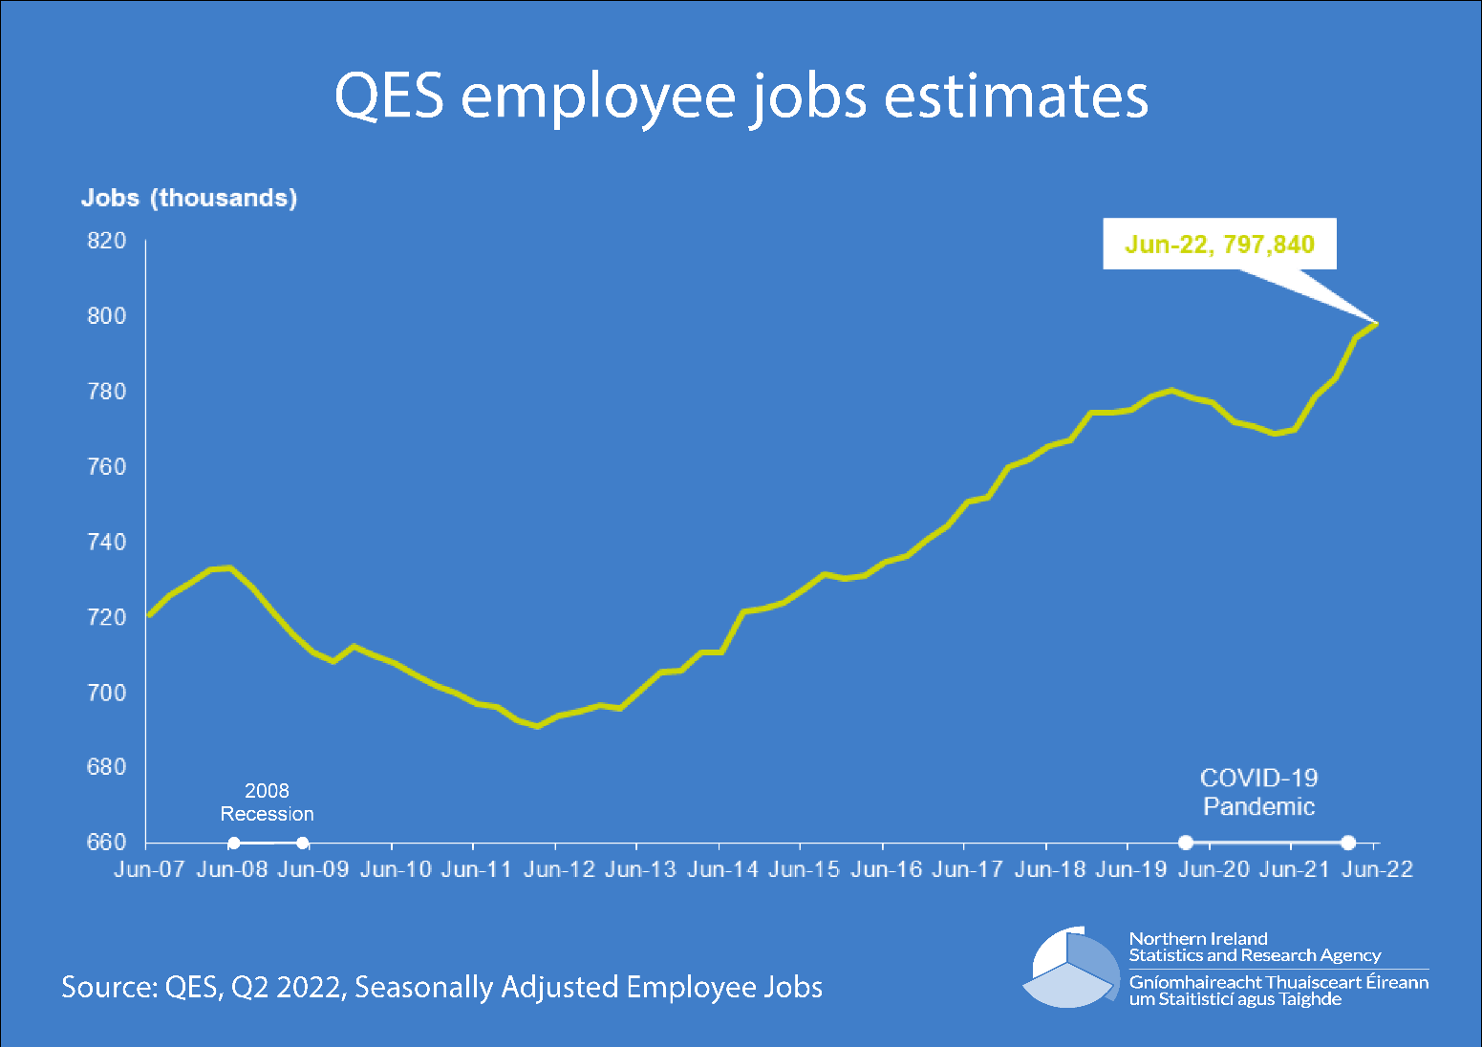


Quarterly Employment Survey (QES)
Key results from Quarter 2 2022
@NISRA
NISRA

Slide 57
You Asked – We Did
Coherence between QES and Furlough data
COVID-19 pandemic presented an unique challenge in recording the number of employee jobs.
March 2020: Introduction of the Coronavirus Job Retention Scheme (CJRS) i.e. Furlough.
Our response? Two questions added to the QES survey:
“Has the named business availed of the Coronavirus Job Retention Scheme (furlough) since its introduction in April 2020” (September 2020)
“If your business has availed of the Coronavirus Job Retention Scheme (furlough), please record the number of employees working for the business named on the front of the questionnaire who were furloughed on 1 June 2020” (June 2020)
June 2020: HMRC started publishing statistics on furloughed employees on the CJRS, including regional breakdown for Northern Ireland.
HMRC administrative data from CJRS provided a valuable resource which we could compare QES furlough estimates against.

Slide 58
You Asked – We Did
Section C: Manufacturing
Division 10: Manufacture of food products
Group 10.8: Manufacture of other food products
Class 10.83: Processing of tea and coffee
Sub-class 10.83/1: Tea processing
Imputation: average proportion of furloughed jobs in responding businesses.
Essential criteria: minimum 5 responding businesses

Slide 59
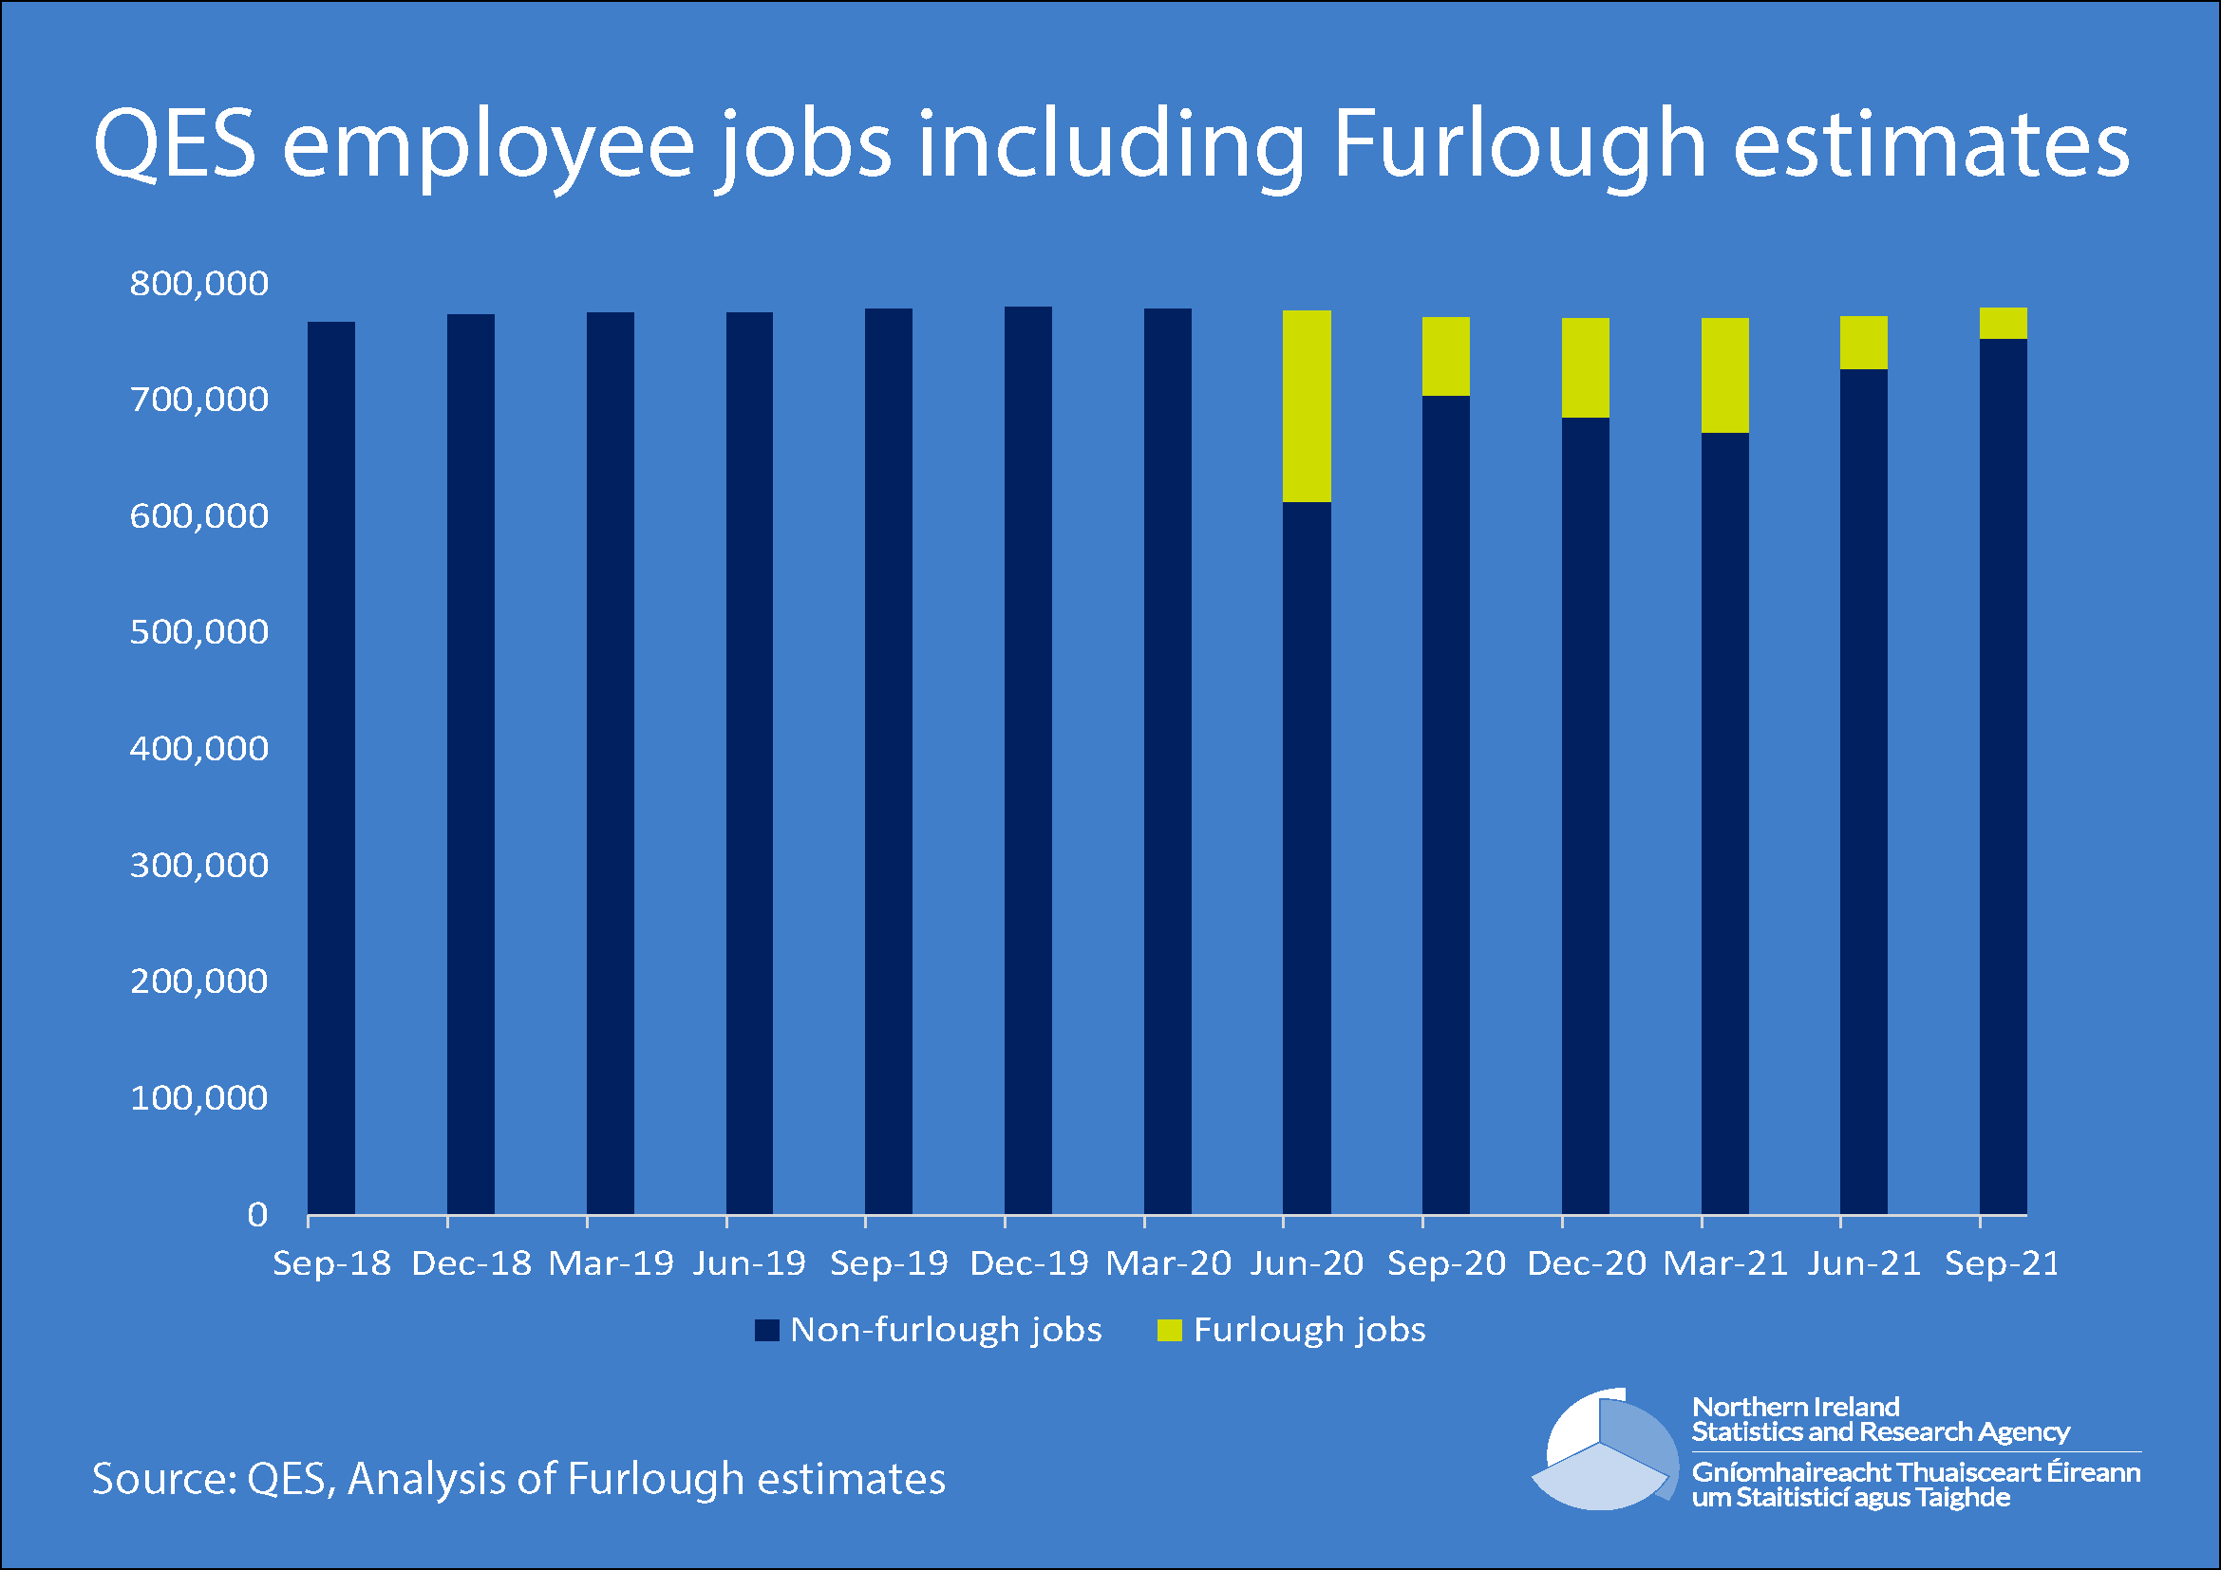
You Asked – We Did
Furlough estimates

Slide 60
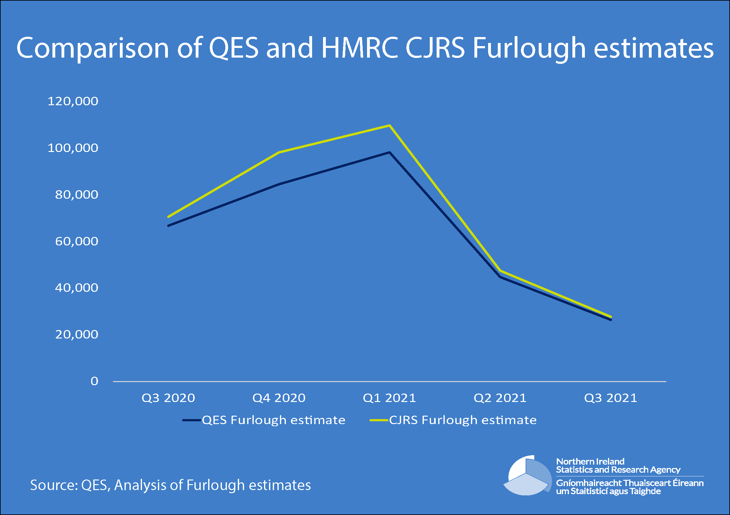
You Asked – We Did
Furlough estimates

Slide 61
You Asked – We Did
Coherence
Source – survey estimate compared to administrative data.
Measure – QES and CJRS measure number of jobs rather than people.
Reference point – QES survey on specific day, CJRS estimates produced daily.
Flexible furlough – QES did not include flexible furlough.
Statistical methodologies – challenges with both QES and CJRS data.
Region allocated – CJRS National Insurance numbers.
Conclusion – QES methodology for producing furlough estimates was effective and robust.

Slide 62
HMRC PAYE Real Time Information (RTI)
ONS produce experimental statistics on employee counts and earnings.
Source - HMRC Pay As You Earn Real Time Information.
Administrative data source of all payroll employees.
New methods for monthly employment and earnings estimates.
Definitional issues.
Release schedule:
13 September 2022 (current release)
11 October 2022 (next release)
Web link: https://www.ons.gov.uk/employmentandlabourmarket/peopleinwork/earningsandworkinghours/datasets/realtimeinformationstatisticsreferencetableseasonallyadjusted

Slide 63
Quarterly Employment Survey (QES)
Next publication
Estimates from QES Quarter 3 2022 will be published on Tuesday 13th December 2022 on the QES website:
https://www.nisra.gov.uk/statistics/labour-market-and-social-welfare/quarterly-employment-survey
Further Information
Further information on the background and methodology of the QES, as well as the full publication document and a suite of accompanying tables (including breakdowns by gender, working pattern, public/private sector, and industrial activity at the two-digit SIC level) is available on the QES website:
https://www.nisra.gov.uk/statistics/labour-market-and-social-welfare/quarterly-employment-survey
Contact: Ciaran Kerr
Email: Ciaran.Kerr@nisra.gov.uk

Slide 64
Q&A

Slide 65
Thank you

